Slide 1
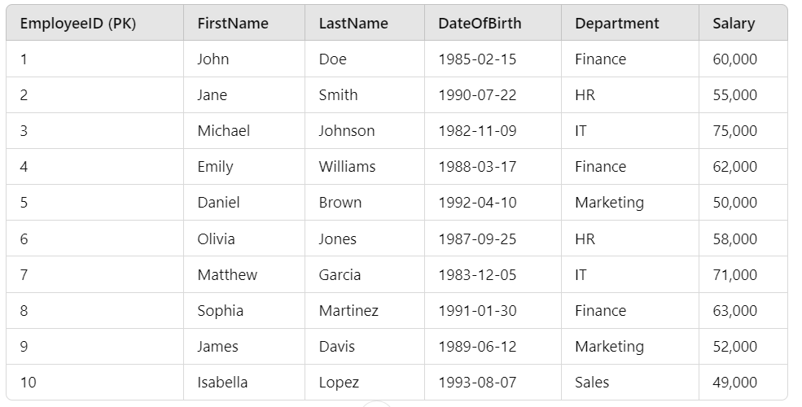
Clustered indexing
c

Slide 2
Clustered indexing…
Clustered indexes store data physically in the order of the indexed column. Since EmployeeID is the primary key and clustered index, when you query by EmployeeID, it will efficiently locate the row.

Slide 3

Non-clustered indexing
Non-Clustered Index Example (on LastName)

Slide 4
